Slide 1

Elementary Programming
TUIT
C++ Programming, Fall 2016
Lecture #2
II – part

Slide 2
TUIT
Roadmap
Last week we covered
Introduction to Computers, Programs, and C++
This week we will learn
Evaluating Expressions and Operator Precedence
Case Study: Displaying the Current Time
Augmented Assignment Operators
Increment and Decrement Operators
Numeric Type Conversions
Software Development Process
Case Study: Counting Monetary Units
Common Errors

Slide 3

TUIT
Evaluating Expressions and Operator Precedence
C++ expressions are evaluated in the same way as arithmetic expressions.
Writing numeric expressions in C++ involves a straight forward translation of an arithmetic expression using C++ operators. For example, the arithmetic expression:
$$\frac{3+4x}{5}−\frac{10\left(y−5\right)\left(a+b+c\right)}{x}+9(\frac{4}{x}+\frac{9+x}{y})$$
can be translated into a C++ expression as
(3 + 4 * x) / 5 – 10 * (y - 5) * (a + b + c) / x + 9 * (4 / x + (9 + x) / y)

Slide 4
TUIT
Operator precedence rule
Here is an example of how an expression is evaluated:
3 + 4 * 4 + 5 * (4 + 3) – 1
3 + 4 * 4 + 5 * 7 – 1
3 + 16 + 5 * 7 – 1
3 + 16 + 35 – 1
19 + 35 – 1
54 – 1
53
(1) Inside parentheses first
(2) multiplication
(3) multiplication
(4) addition
(5) addition
(6) substraction

Slide 5
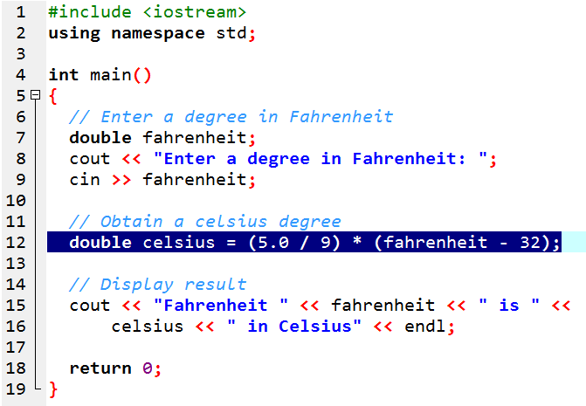


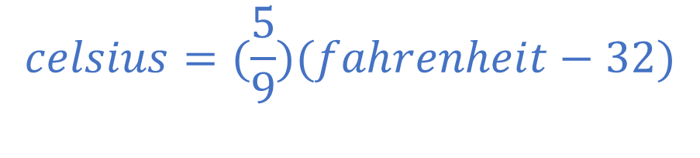
TUIT
Example
Fahrenheit degree converts to Celsius degree using following formula:
$$celsius=(\frac{5}{9})(fahrenheit−32)$$
Enter a degree in Fahrenheit: 100 Fahrenheit 100 is 37.7778 in Celsius

Slide 6
TUIT
Case Study: Displaying the Current Time
You can invoke the time(0) function to return the current time.
The time(0) function, in the ctime header file, returns the current time in seconds elapsed since the time 00:00:00 on January 1, 1970. This time is known as the UNIX epoch.
Elapsed time
time
UNIX epoch 01-01-1970 00:00:00 GMT
Current time time(0)

Slide 7
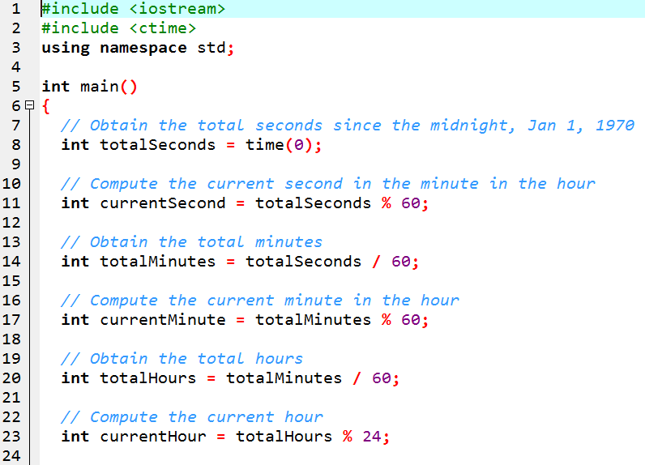
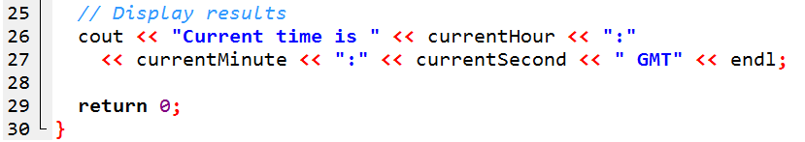
TUIT
Greenwich Main Time
Current time is 17:31:26 GMT

Slide 8
TUIT
Augmented Assignment Operators
The operators +, -, *, /, and % can be combined with the assignment operator to form augmented operators.
Operator | Name | Example | Equivalent
+= | Addition assignment | i += 8 | i = i + 8
-= | Subtraction assignment | i -= 8 | i = i – 8
*= | Multiplication assignment | i *= 8 | i = i * 8
/= | Division assignment | i /= 8 | i = i / 8
%= | Modulus assignment | i %= 8 | i = i % 8

Slide 9
TUIT
Augmented Assignment Operators
x /= 4 + 5.5 * 1.5; same x = x / (4 + 5.5 * 1.5);
+ = is wrong! += is right!
x += 2; //Statement
cout << (x += 2); // Expression
Here has a space
Here hasn’t a space

Slide 10
TUIT
Check Point
Show the printout of the following code:
int a = 6;
a -= a + 1;
cout << a << endl;
a *= 6;
cout << a <<endl;
a /= 2;
cout << a << endl;

Slide 11
TUIT
Increment and Decrement Operators
The increment (++) and decrement (--) operators are for incrementing and decrementing a variable by 1.
int i = 3, j = 3;
i++; // i becomes 4
j--; // j becomes 2
int i = 3, j = 3;
++i; // prefix increment
--j; // prefix decrement
int i = 3, j = 3;
i++; // postfix increment
j--; // postfix decrement

Slide 12
TUIT
Increment and Decrement Operators
Operator | Name | Description | Example (assume i = 1)
++var | Preincrement | Increment var by 1 and use the new var value in the statement | int j = ++i; // j is 2, i is 2
var++ | Postincrement | Increment var by 1, but use the original var value in the statement | int j = i++; // j is 1, i is 2
--var | Predecrement | Decrement var by 1 and use the new var value in the statement | int j = --i; //j is 0, I is 0
var-- | Postdecrement | Decrement var by 1 and use the original var value in the statement | int j = i--; // j is 1, i is 0

Slide 13
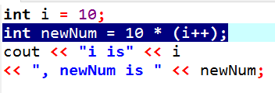

TUIT
Increment and Decrement Operators
int newNum = 10* i; i = i +1;
Same effect as
i is 11, newNum is 100
i = i +1; int newNum = 10 * i;
Same effect as
i is 11, newNum is 110

Slide 14
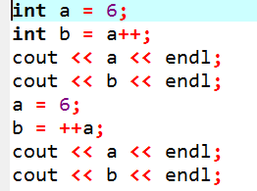
TUIT
Check Point
Show the printout of the following code:

Slide 15
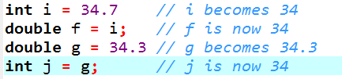
TUIT
Numeric Type Conversions
Floating – point numbers can be converted into integers using explicit casing.
C++ automatically converts the integer to a floating – point value. So, 3*4.5 is the same as 3.0 * 4.5.
cout << 1 / 2; //output 0.
int i = (int) 5.4; // i equal 5.

Slide 16
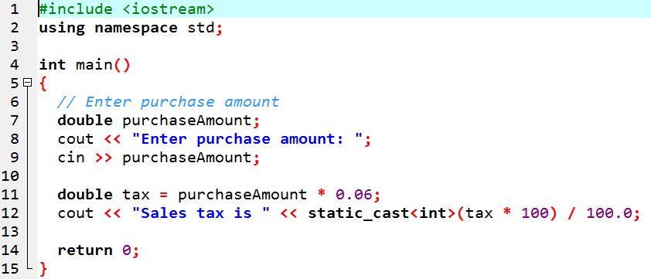
TUIT
Numeric Type Conversions
SalesTax.cpp
Enter purchase amount: 197.55 Sales tax is 11.85

Slide 17
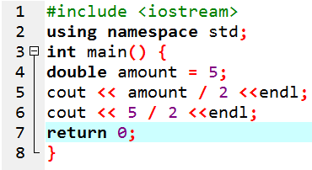
TUIT
Check Point
Show the printout of the following code:

Slide 18
TUIT
Software Development Process
The software development life cycle is a multi-stage process that includes requirements specification, analysis, design, implementation, testing, deployment, and maintenance.
Requirements Specification
System Analysis
System Design
Implementation
Testing
Deployment
Maintenance

Slide 19
TUIT
Software Development Process
Requirements specitication is a formal process that seeks to understand the problem that the software will address and to document in detail what the software system must do.
System analysis seeks to analyze the data flow and to identify the system’s input and output.
System design is the process for obtaining the output from the input.
Implementation involves translating the system design into programs.
Testing ensures that the code meets the requirements specififation and weeds out bugs.
Deployment makes the software available for use.
Maintenance is concerned with updating and improving the product

Slide 20
TUIT
Requirements Specification
Stage 1:
The program must satisfy the following requirements:
Allow the user to enter the annual interest rate, loan amount, and number of years for which payments will be made;
Compute and display the monthly payment and total payment amounts;

Slide 21

TUIT
System Analysis
The output is the monthly payment and total payment, which can be obtained using the following formulas:
$$monthlyPayment= \frac{loanAmount×monthlyInterestRate}{1−\frac{1}{{(1+monthlyInterestRate)}^{numberOfYears×12}}}$$
$$totalPayment=monthlyPayment×numberOfYears×12$$
Therefore, the input needed for the program is the monthly interest rate, the length of the loan in years, and the loan amount.

Slide 22
TUIT
System Design
During system design, you identify the steps in the program.
Step 1. Prompt the user to enter the annual interest rate, the loan amount, and the number of years.
Step 2. The input for the annual interest rate is a number in percent format, such as 4.5%. To obtain the monthly interest rate from the annual interest rate, divide it by 12, since a year has 12 month.
Compute the monthly payment using the preceding formula.
Compute the total payment, which is the monthly payment multiplied by 12 and multiplied by the number of years.
Display the monthly payment and total payment.

Slide 23
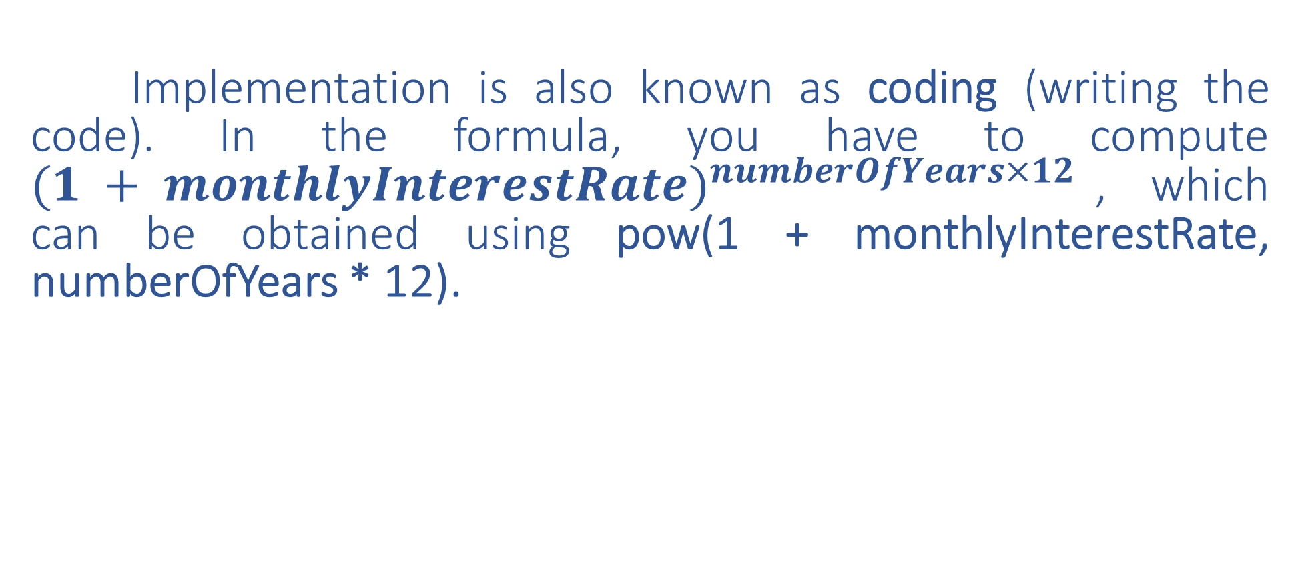
TUIT
Implementation
Implementation is also known as coding (writing the code). In the formula, you have to compute ${(1 + monthlyInterestRate)}^{numberOfYears×12}$, which can be obtained using pow(1 + monthlyInterestRate, numberOfYears * 12).

Slide 24
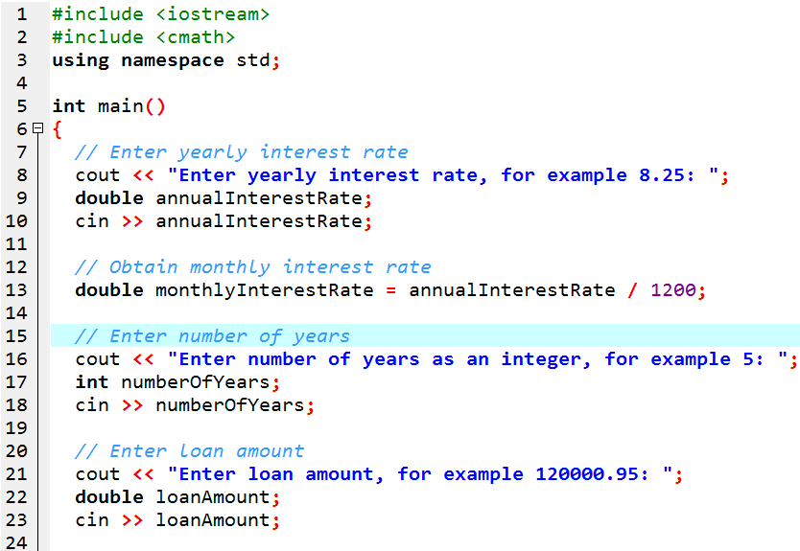
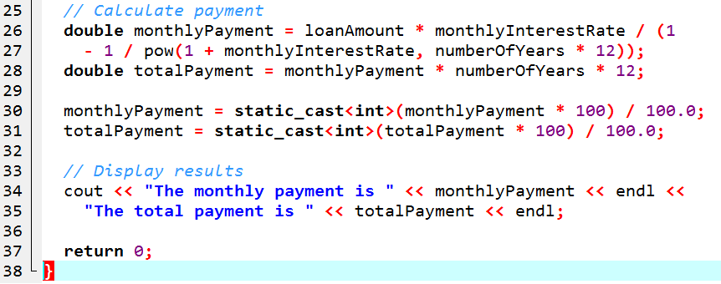
TUIT
Implementation
Enter yearly interest rate, for example 8.25: 3 Enter number of years as an integer, for example 5: 5 Enter loan amount, for example 120000.95: 1000 The monthly payment is 17.96 The total payment is 1078.12

Slide 25
TUIT
Testing
After the program is implemented, test it with some sample input data and verify whether the output is correct.

Slide 26

TUIT
Check Point
How would you write the following arithmetic expression?
$$\frac{−b+\sqrt{b^{2}−4ac}}{2a}$$

Slide 27
TUIT
Case Study: Counting Monetary Units
This section presents a program that breaks a large amount of money into smaller units.
Here are the steps in developing the program:
Prompt the user to enter the amount as a decimal number, such as 11.56
Convert to amount (e.g. 11.56) into cents (1156)
Divide the cents by 100 to find the number of dollars. Obtain the remaining cents using the cents remainder 100
Divide the remaining cents by 25 to find the number of quarters. Obtain the remaining cents using the remaining cents remainder 25
Divide the remaining cents by 10 to find the number of dimes. Obtain the remaining cents using the remaining cents remainder 10
Divide the remaining cents by 5 to find the number of nickels. Obtain the remaining cents using the remaining cents remainder 5
The remaining cents are pennies
Display the result

Slide 28
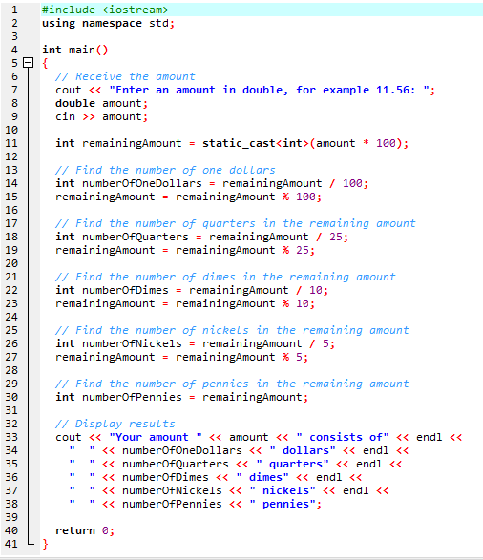
TUIT
ComputeChange.cpp
Enter an amount in double, for example 11.56: 11.56 Your amount 11.56 consists of 11 dollars 2 quarters 0 dimes 1 nickels 1 pennies

Slide 29
TUIT
Common Errors
Common elementary programming errors often involve undeclared variables, unitialized variables, integer overflow, unintended integer division, and round-off errors.
Common Error 1: Undeclared/Uninitialized Variables and Unused Variables.
double interestRate = 0.05;
double interest = interestrate * 45
Common Error 2: Integer Overflow (Numbers are stored with a limited number of digits)
short value = 32767 + 1; // value will actually become -32768
short value = -32768 – 1; // value will actually become 32767
Common Error 3: Round-off Errors.
float a = 1000.43;
float b = 1000.0;
cout << a – b << endl;
Displays 0.429993, not 0.43. Integers are stored precisely. Therefore, calculations with integers yield a precise integer result.

Slide 30
TUIT
Common Errors
Common errors 4: Unintended Integer Division
int number1 = 1; int number2 = 2; double average = (number1 + number2) / 2; cout << average <<endl;
int number1 = 1; int number2 = 2; double average = (number1 + number2) / 2.0; cout << average <<endl;
Common errors 5: Forgetting Header Files
Forgetting to include appropriate header files is a common compile error. The pow function is defined in the cmath (or math.h) header file and the time function is defined in the ctime header file.

Slide 31
TUIT
Summary
The cin object along with the stream extraction operator (>>) can be used to read an input from the console.
Identifiers are names for naming elements in a program.
Choosing descriptive identifiers can make programs easy to read.
Declaring a variable tells the compiler what type of data a variable can hold.
In C++, the equal sign ( = ) is used as the assignment operator.
A variable declared in a function must be assigned a value.
A named constant is declared by using the keyword const.
By convention, constants are named in uppercase.
C++ provides integer types (short, int, long, unsigned short, unsigned int, and unsigned long) that represent singed and unsigned integers of various sizes.
Unsigned integers are nonnegative integers.
C++ provides floating – point types (float, double, and long double) that represent floating – point numbers of various precisions.

Slide 32
TUIT
Summary
C++ provides operators that perform numeric operations: + (addition), - (subtraction), * (multiplication), / (division), and % (modulus).
Integer arithmetic (/) yields an integer result
In C++, the % operator is for integers only.
The numeric operators in a C++ expression are applied the same way as in an arithmetic expression
The increment operator (++) and the decrement operator (--) increment or decrement a variable by 1.
C++ provides augmented operators += , -=, *=, /=, %=.
When evaluating an expression with values of mixed types, C++ automatically casts the operands to appropriate types.
You can explicitly cast a value from one type to the other using the <static_cast>(type) notation or the legacy c-style (type) notation.
In computer science, midnight of January 1, 1970 is know as the UNIX epoch.

